Slide 1

Estimating the abundance of imperilled apex predators:
A comparison of census methods
Ashley Frisch ¹ & Justin Rizzari ²
¹ ARC Centre of Excellence for Coral Reef Studies
² School of Marine and Tropical Biology, James Cook University
Notes:
This is a simple but very important study because it addresses a fundamental issue in many shark research programs. That is potential bias in shark survey methods. This study came about due to scepticism that sharks on the GBR were in decline, and that fishing was responsible. Basically, there was a lack of acceptance of the results of shark stock assessments based on fishery-independent surveys.

Slide 2
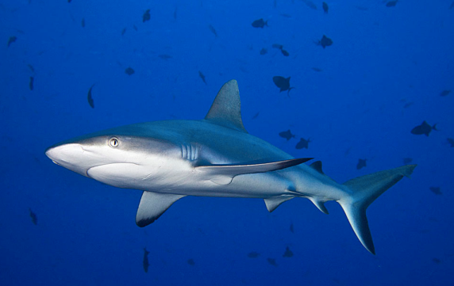
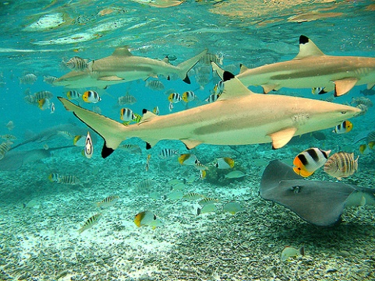
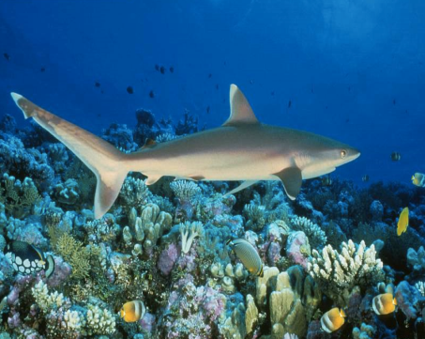
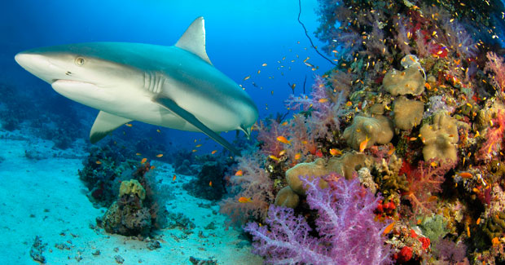
Why count sharks?
Effective census methods needed for …
- monitoring
- stock assessments
- ecological studies
No targeted commercial fisheries
- research reliant on nontraditional census methods
No consensus about reliability of census methods
- management and conservation efforts become distracted
Notes:
Recent years has seen renewed interest in the condition of shark populations.
Tourism value: shark sightings are valued at $100’s. Value of a living shark can far outweigh its value when sold as a one-off fisheries product.
Shark declines in Pacific (Friedlander & DeMartini; Robbins et al.), Caribbean (Ward-Paige et al.) and Indian Ocean (Graham et al.).

Slide 3
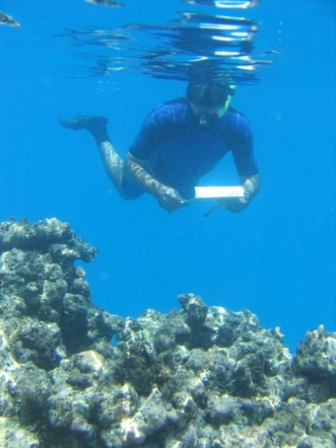
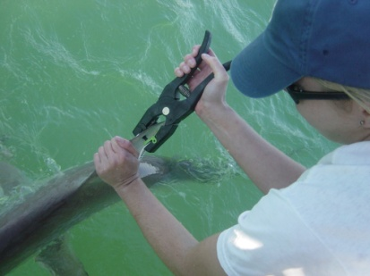
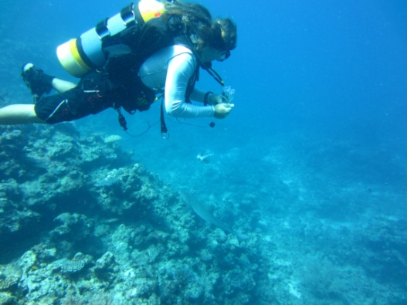
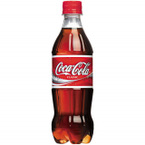
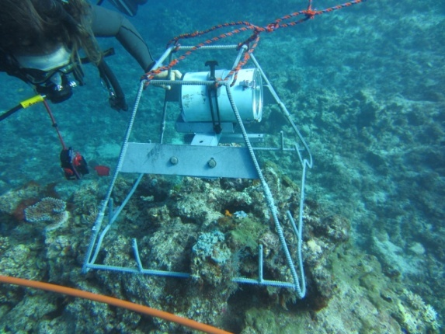
Census methods for counting sharks
Catch-per-unit-effort
Catch-mark-recapture
Transect or timed-swim
Towed diver
Remote underwater video
Stationary point count
Audible stationary count
(squeaky bottle)

Slide 4
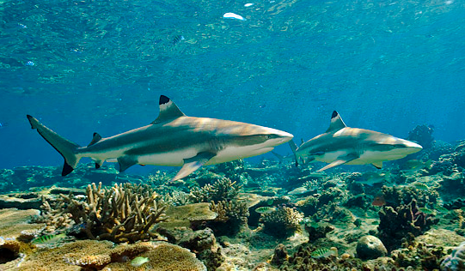
Census methods for counting sharks
Sampling considerations:
Relative vs absolute abundance
Instantaneous vs non-instantaneous
Diver effects (attraction/avoidance)
Learned behaviour
Project aim: to evaluate the performance of census methods across a gradient of human interaction (fished, unfished, no-entry reefs)
Notes:
We repeated our evaluation across a spatial gradient of human interaction (fished, unfished, no-entry reefs) to quantify any potential bias caused by learned behaviour of reef sharks towards humans.

Slide 5
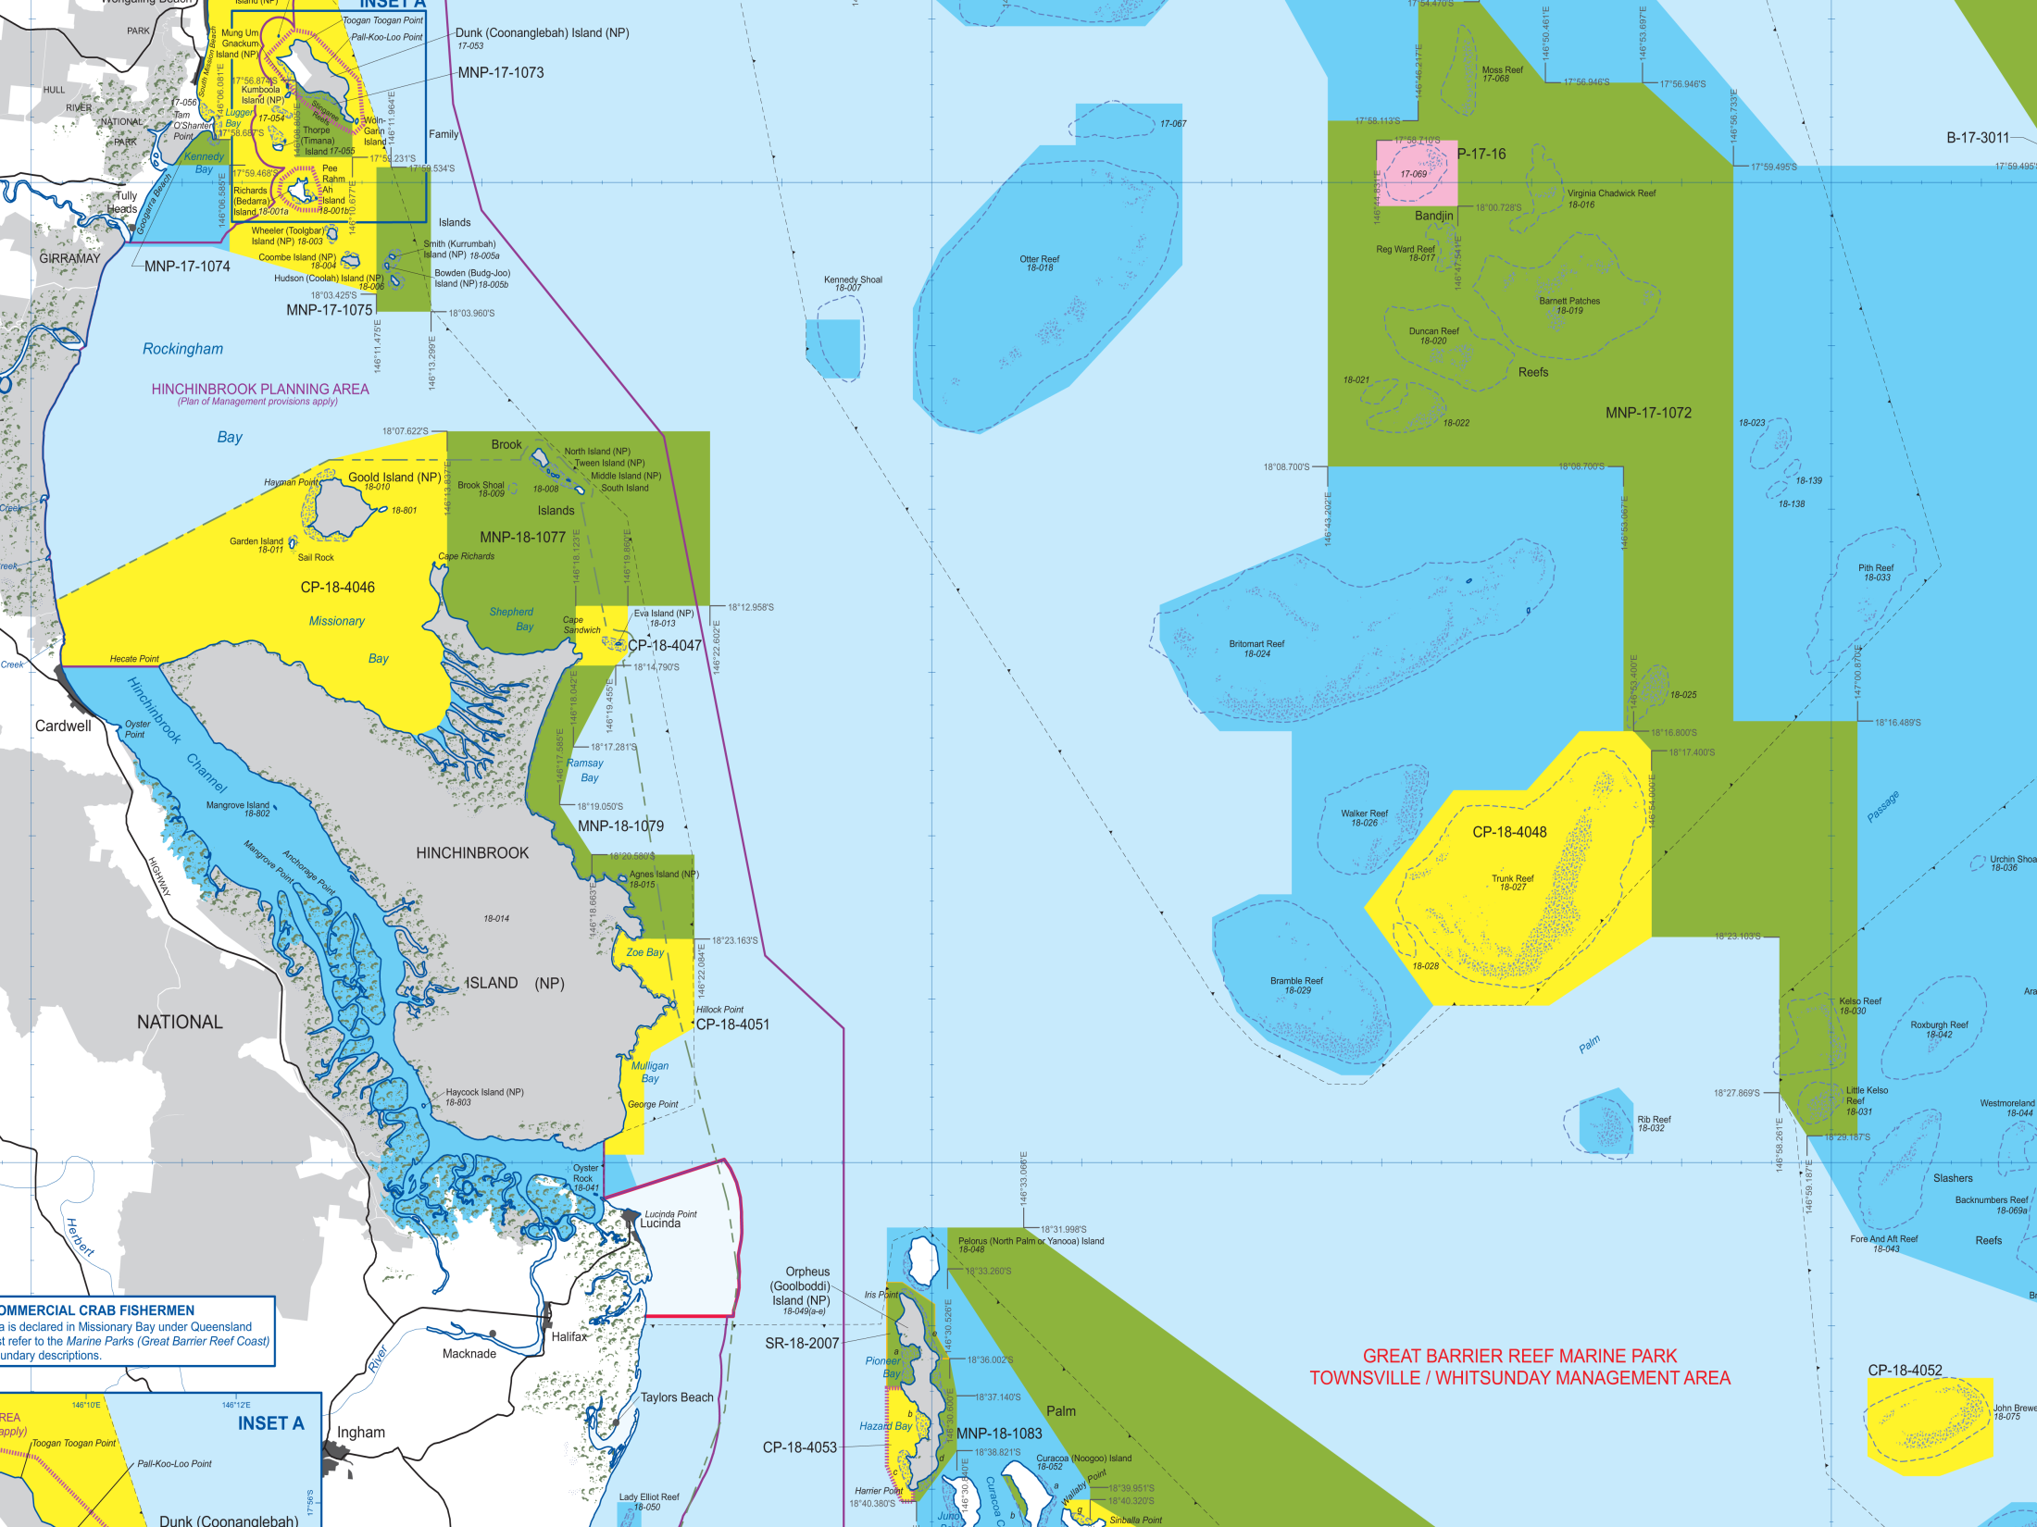

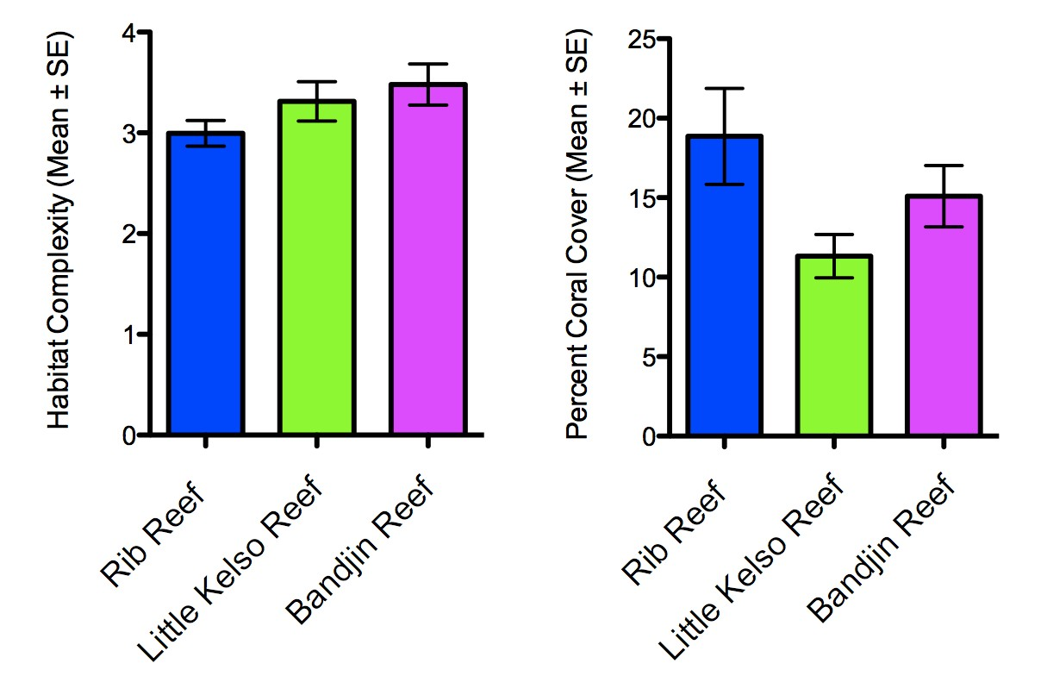
Bandjin Reef
(no-entry)
Rib Reef
(fished)
Little Kelso Reef (unfished)
High
Human interaction
None
Notes:
All three reefs are similar in size and habitat characteristics, but differ in relation to human interaction.
Pink zones are easy to enforce (easier than green zones).

Slide 6
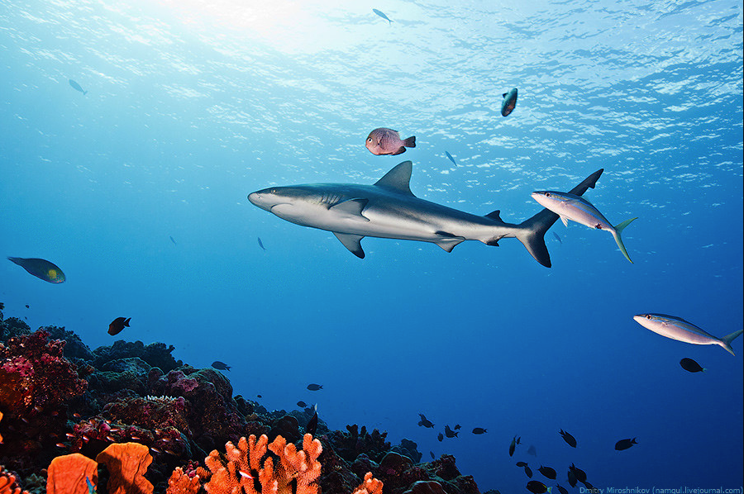
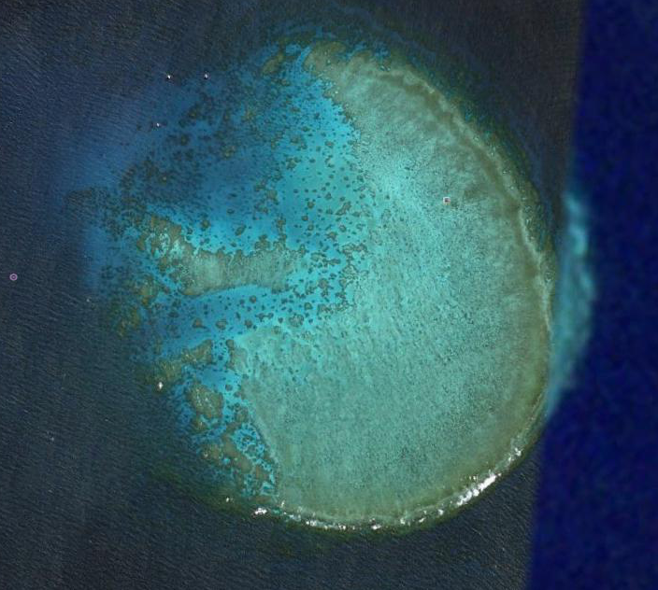
Experimental design
15 replicates per method per reef
Same sites (but different days) for each method
Swim = 45 min, Tow = 22 mins, BRUV = 60 min, ASC = 10 min,
Long-line (10 hooks) = 60 min
Individual characteristics (species, size, sex, scars, remoras, etc.)
Standardized census area (sharks per hectare)
Rib Reef

Slide 7
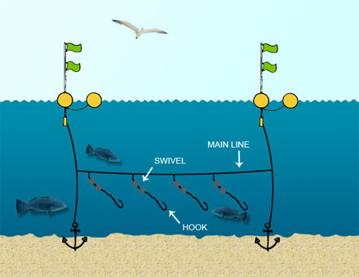
Results
Method | White-tip | Grey-reef | Black-tip | Tiger | Tawny-nurse
Timed-swim |  |  |  | - | 
Towed-diver |  |  |  | - | -
BRUV |  |  |  |  | 
Squeaky bottle |  |  | - | - | -
CPUE and CMR – too low catch rates and too much bycatch
SPC – too few sharks

Slide 8
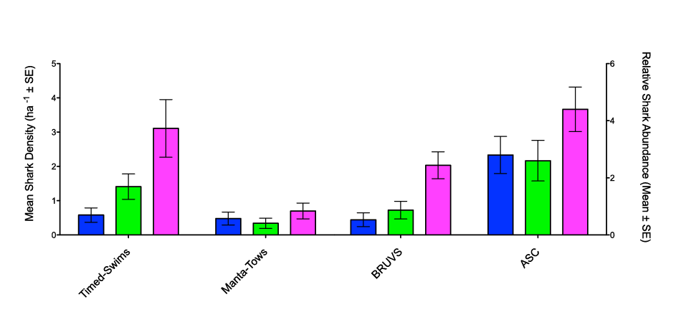
Rib Reef Kelso Reef Bandjin Reef
b
b
ab
a
a
a
Towed-diver
BRUV
Squeaky bottle
Area of attraction (AoA)
BRUV = Π/12 × (T_{soak} × V_{current})² /10⁴ (0.65 ha)
Squeaky-bottle = Πr² / 10⁴ / B_{reef}/B_{ocean} (1.31 ha)
Notes:
Shark swimming speed was not included in the model because it was not considered to be a limiting factor. Vast majority of sharks arrived within 40min of BRUV and 4min of Squeaky-bottle.

Slide 9
Rib Reef Kelso Reef Bandjin Reef
b
b
ab
a
a
a
BRUV
Timed-swim
Towed-diver
Squeaky-bottle
Estimates of abundance were method-dependent
Steep density gradient is probable given relative fishing pressure
and density gradient of fishes (potential prey)

Slide 10
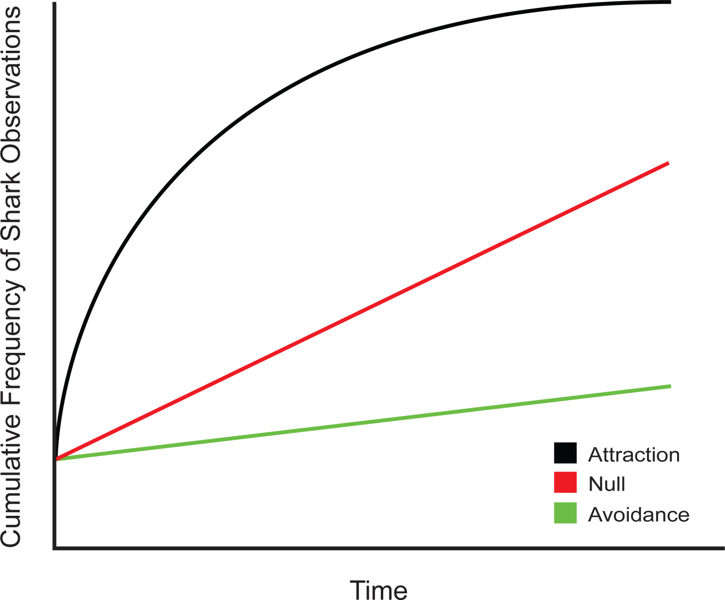
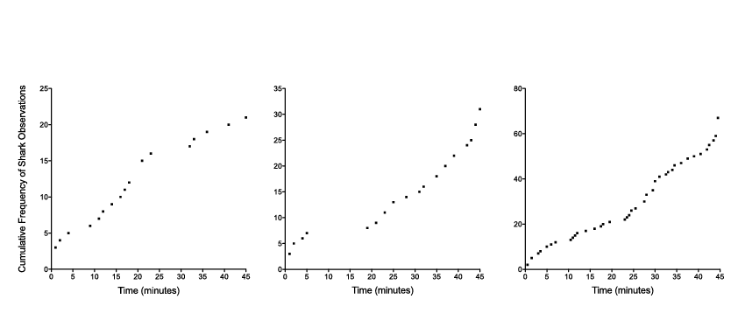
How do sharks respond to divers?
Timed-swims: time of encounter
Encounter rate was constant and
distribution of observation times was
uniform
Rib Reef Kelso Reef Bandjin Reef
Notes:
Change to cumulative percent.

Slide 11
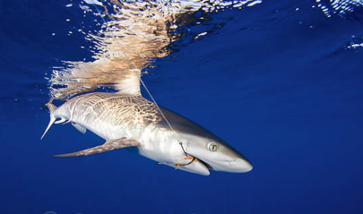
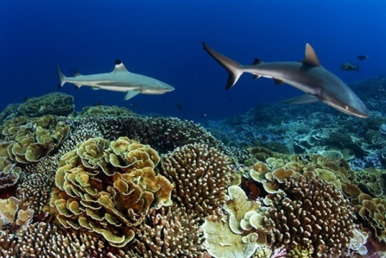
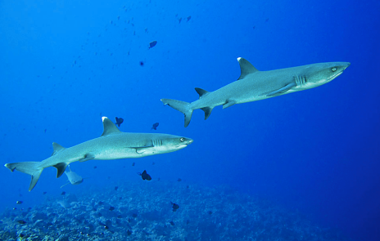
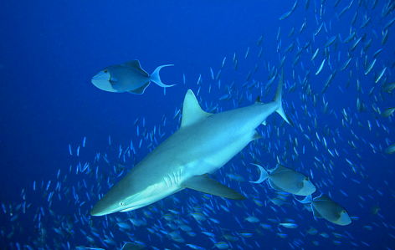
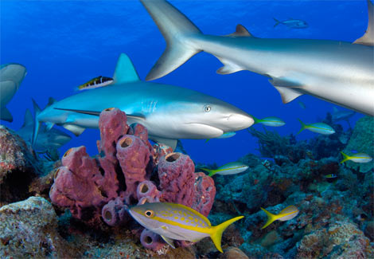
Conclusions
Timed-swim & BRUV appear accurate and reliable
(caveat: BRUV dependent on AoA model)
Towed-diver method should be used with caution (appears to repel sharks)
No evidence of attraction or avoidance toward divers, regardless of prior
opportunities for interaction
Improved acceptance of diver-based census methods (particularly timed
swims and transects)
Notes:
Previously, some stakeholders claimed that patterns of abundance across management zones could be explained by shark behaviour towards divers. The significance of the results that I just presented is that there should now be greater acceptance of past and future research that utilize diver-based census methods. This is critical given the threats facing apex predators and the need for effective management regimes based on defensible census methods.

Slide 12


Credits
Mike Cappo and the Australian Institute of Marine Science for access to BRUVs
Australian Research Council for funding
Great Barrier Reef Marine Park Authority for access to preservation zones

